Slide 1
ANOMALY DETECTION USING RNN
PRESENTED BY.,
BARANIKA G
821721104301
BE.CSE
SIR ISSAC NEWTON COLLEGE OF ENGINEERING AND TECHNOLOGY
3/21/2024 Annual Review

Slide 2

Anomaly Detection using RNN
3/21/2024 Annual Review

Slide 3


AGENDA
Anomaly Detection involves
several steps
Statistical Methods
Time Series Analysis
Deep Learning
Ensemble Methods
Domain-Specific Techniques
Machine Learning Techniques
3/21/2024 Annual Review

Slide 4

PROBLEM STATEMENT
Anomaly detection using Recurrent Neural Networks (RNNs) involves identifying patterns in sequential data and detecting deviations or anomalies from these patterns.
The effectiveness of anomaly detection using RNNs depends on factors such as the quality of the training data, the choice of RNN architecture, the selection of hyperparameters, and the appropriateness of the anomaly detection strategy for the specific application domain.
3/21/2024 Annual Review

Slide 5

PROJECT OVERVIEW
Explanation of the importance of anomaly detection in various industries and applications.
Overview of the project's aim to develop an effective anomaly detection system.
Definition of anomaly detection and its relevance in identifying unusual patterns or outliers in data.
Explanation of the challenges involved in detecting anomalies and the need for robust detection methods.
3/21/2024 Annual Review

Slide 6

WHO ARE THE END USERS?
Financial Institutions
Cybersecurity Professionals
Manufacturing and Industrial Automation
Healthcare Providers
E-commerce and Retail
Telecommunications Companies
Energy and Utilities
Transportation and Logistics
IoT (Internet of Things) Applications
Government and Law Enforcement
3/21/2024 Annual Review

Slide 7

YOUR SOLUTION AND ITS VALUE PROPOSITION
An anomaly detection solution is a system designed to identify patterns in data that deviate from normal behavior, indicating potential anomalies or outliers. The value proposition of such a solution lies in its ability to provide early detection of abnormal events or behaviors. Here are some key aspects of the value proposition of an anomaly detection solution:
Early Detection of Anomalies
Risk Mitigation
Improved Operational Efficiency
Enhanced Security
Cost Savings
Data-driven Decision Making
Compliance and Regulatory Compliance
3/21/2024 Annual Review

Slide 8

THE WOW IN YOUR SOLUTION
An impressive solution for anomaly detection in Recurrent Neural Networks (RNNs) incorporates several key elements to achieve exceptional performance and effectiveness. Here's a "wow" solution for anomaly detection using RNNs
3/21/2024 Annual Review
8

Slide 9
MODELLING
Anomaly detection can be modeled using various approaches, including statistical methods, machine learning algorithms, and deep learning models. Here's an overview of the modeling process for anomaly detection:
Data Representation
Model Selection
Model Training
Hyperparameter Tuning
Evaluation
Threshold Selection
Model Deployment
Monitoring and Maintenance
3/21/2024 Annual Review
9

Slide 10
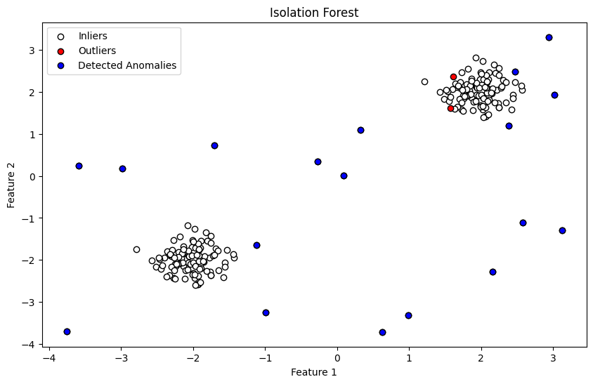
RESULTS Isolation Forest
Demo Link
3/21/2024 Annual Review
10

